Slide 1

Capstone Project
Ayurveda Medicine Order App

Slide 2
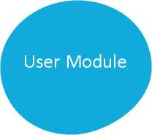
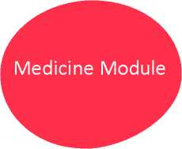
1 ROAD MAP
Application will be developed in following
1. Spring Boot + Rest Controller + Spring Data Jpa
2 PROBLEM STATEMENT
To Create an Application for Ayurveda Medicine
Customer are able to search, buy, modify and order the medicine.
Admin able to perform the below operations:
- view and delete customers
- add, update, delete and view medicine
- view and cancel orders
Customer able to perform the below operations:
- register
- View available medicines
- Place order
- View and cancel order
- View order history
3 MODULES
Order module
Order Module
1

Slide 3
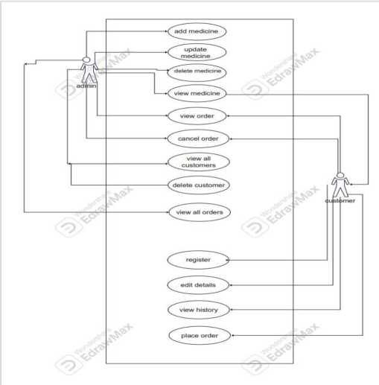
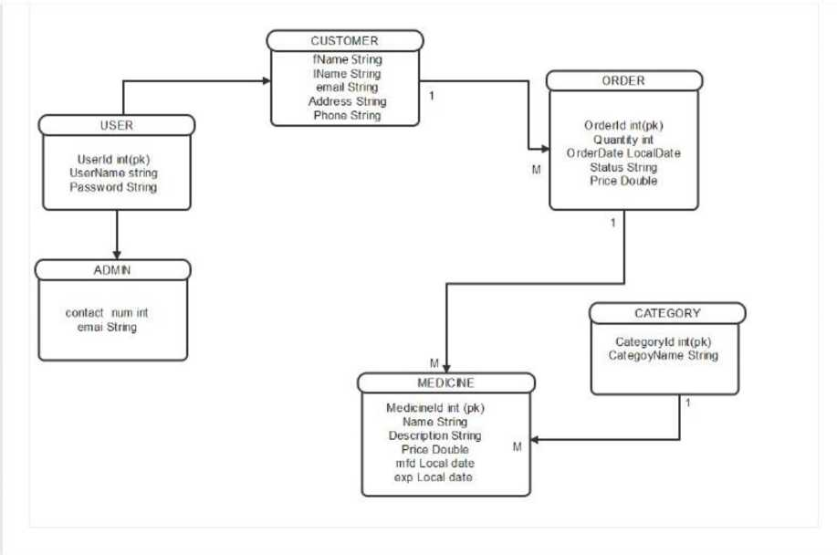
4 USE CASE DIAGRAM
5 CLASS DIAGRAM
2

Slide 4
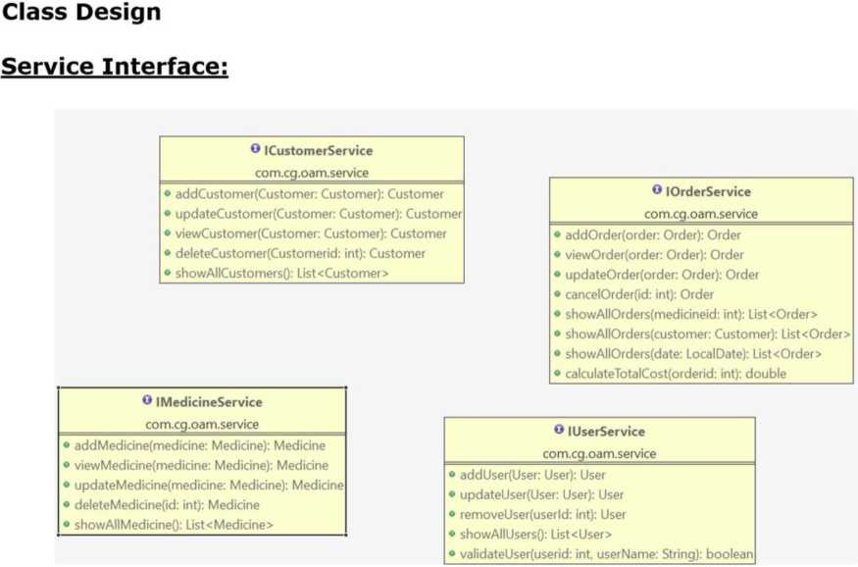
3

Slide 5
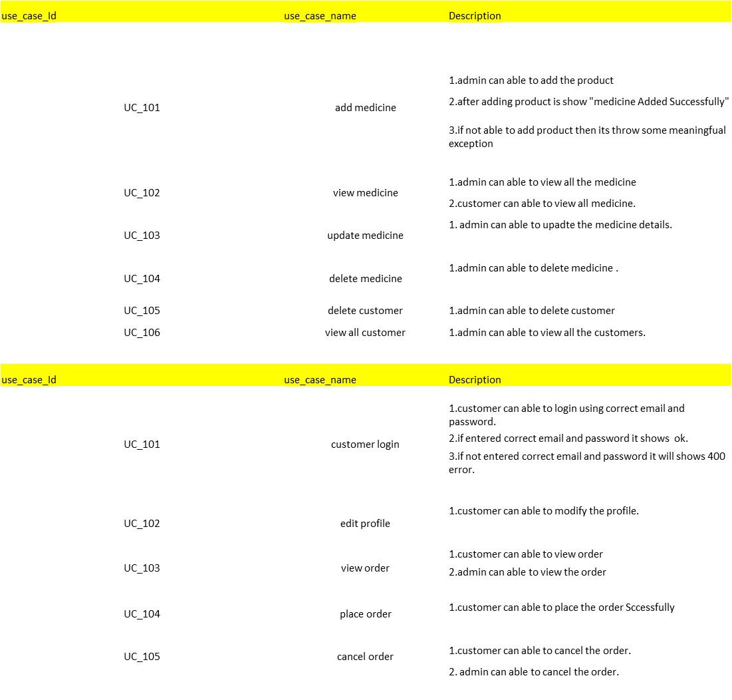
USER STORIES:

